Slide 1
Chapter 5: Ergonomics and the Prevention of Work-Related Musculoskeletal Disorders

Slide 2
Chapter Objectives
Understand the importance of the use of proper posture and body mechanics in sonography.
Gain an appreciation for the basic causes of work-related musculoskeletal disorders in sonography.
Assess the most likely locations of work-related musculoskeletal disorders in sonography.
Explain the ways in which work-related musculoskeletal disorders can be prevented.

Slide 3
What Are Work-Related Musculoskeletal Disorders (WRMSDs)?
Occupational injuries are the main reasons for long-term absences among healthcare workers.
On average, it only takes 5 years for a sonographer to start experiencing pain associated with the job.
Several studies suggest between 80% and 90% of sonographers scan in pain.
WRMSDs are occupationally acquired or aggravated injuries to muscles, tendons, ligaments, or cartilage resulting from repetitive use.
These can lead to pain, swelling, inflammation, spine degeneration, and gradual deterioration of tendons and ligaments.
Pain during exam may subside, but damage to soft tissue accumulates with time.

Slide 4
What Are Work-Related Musculoskeletal Disorders (WRMSDs)? (cont.)
Most common areas of work-related injuries for sonographers
Shoulder—84%
Neck—83%
Wrist—61%
Back—58%
Hands—56%
These injuries are the result of stress or tension applied to particular groups of muscles, nerves, tendons, and ligaments in cycles.

Slide 5
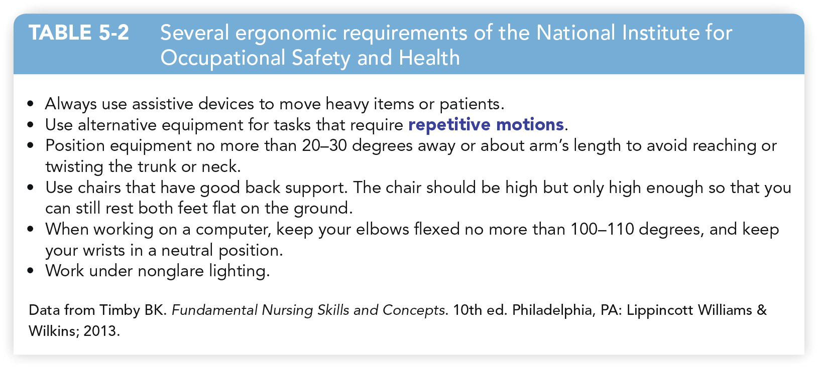
Ergonomics
Ergonomics is the scientific study of creating tools and equipment that help the human body adapt to the work environment.

Slide 6
Body Mechanics
Use of proper body mechanics and making it a habit to think about correct posture before acting can save you from pain.
When you stand, the center of gravity is located at the center of the pelvis.
Maintaining this can save you from pain.
Postural support devices can encourage correct positioning.
Proper body mechanics ensure the spine is in appropriate alignment.
You may have to deviate from correct posture due to a patient’s physical state.
Never hesitate to ask for assistance.

Slide 7
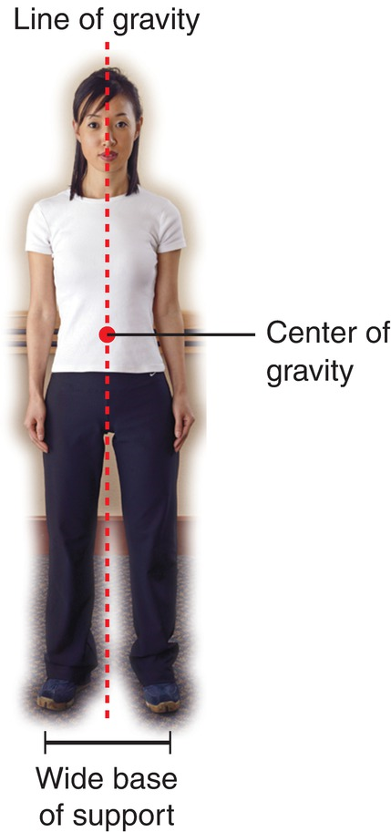
Personal and Environmental Risk Factors
Risk factors for development of WRMSDs include:
Posture and body positioning
Repetitive motions and force
Room and equipment design
Job design
Other threatening physical predisposing factors
Risks specific to some specialties

Slide 8
Posture and Body Positioning
Correct posture means all body parts are aligned and balanced.
Poor posture is often more comfortable than correct posture.
This is due to how we have trained our ligaments, muscles, and tendons to relax in certain positions.
Performing work with poor posture can result in a painful muscle spasm.
Correct posture also includes how you hold your extremities.
The repeated use of awkward abduction and adduction can lead to WRMSDs.
Proper scanning technique is vital.
The more you practice good posture and technique, the more routine they will become.

Slide 9
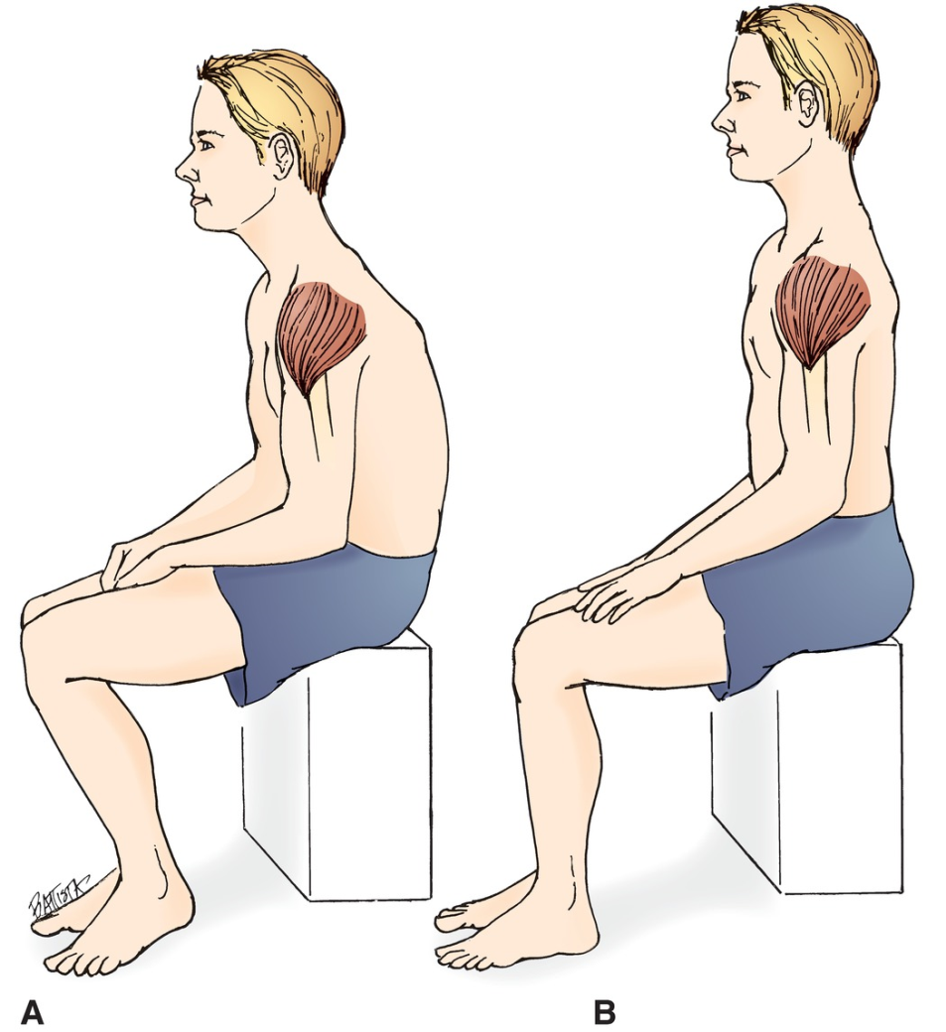
Posture and Body Positioning (cont.)
A. Good sitting posture. B. Poor sitting posture

Slide 10
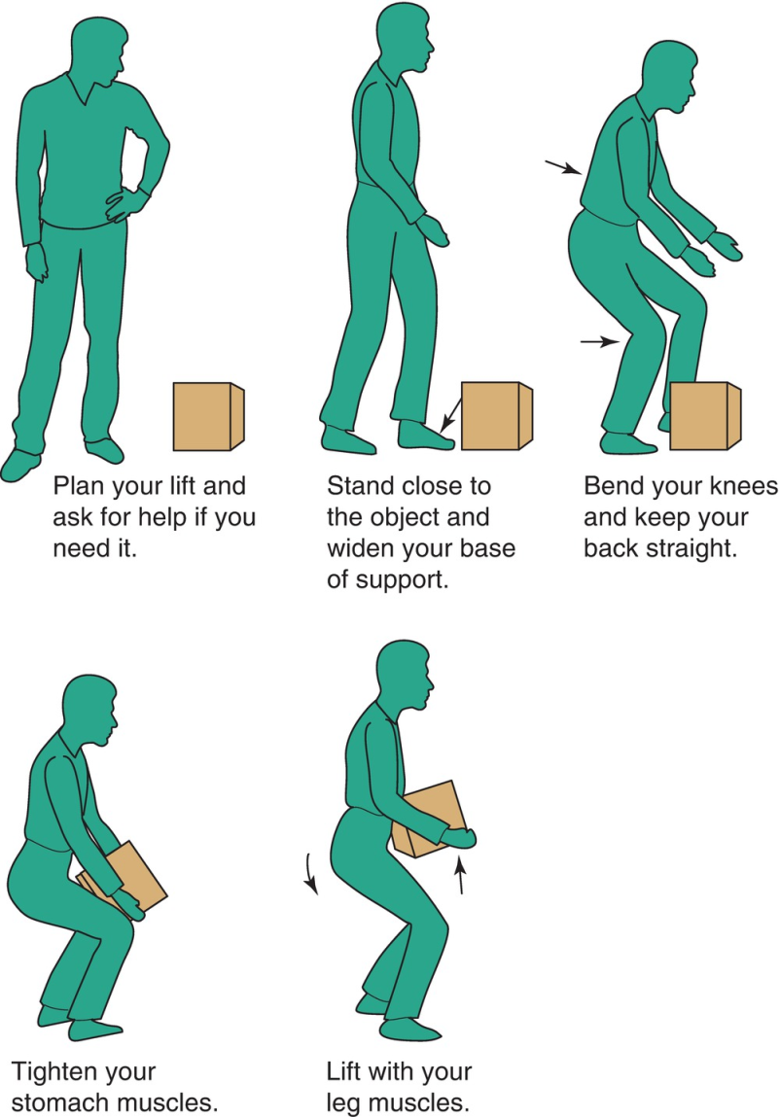
Lifting and Moving

Slide 11
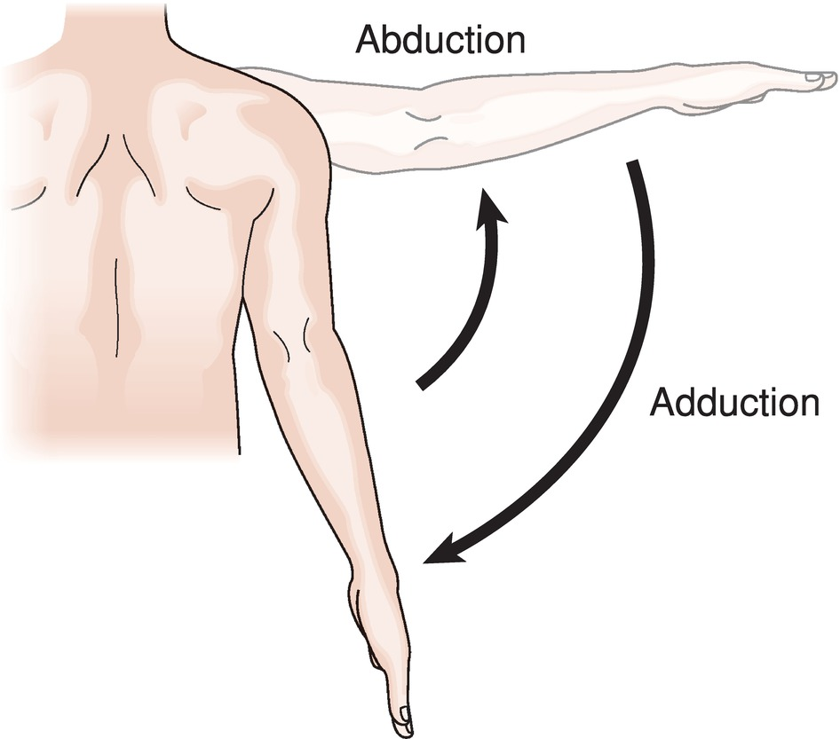
Arm Abduction and Adduction
Abduction of the arm requires that the arm be moved away from the midline of the body.
Adduction is moving the arm closer to the midline.
Overreaching beyond 30 cm for a prolonged period of time can result in muscle fatigue and possible injury.

Slide 12
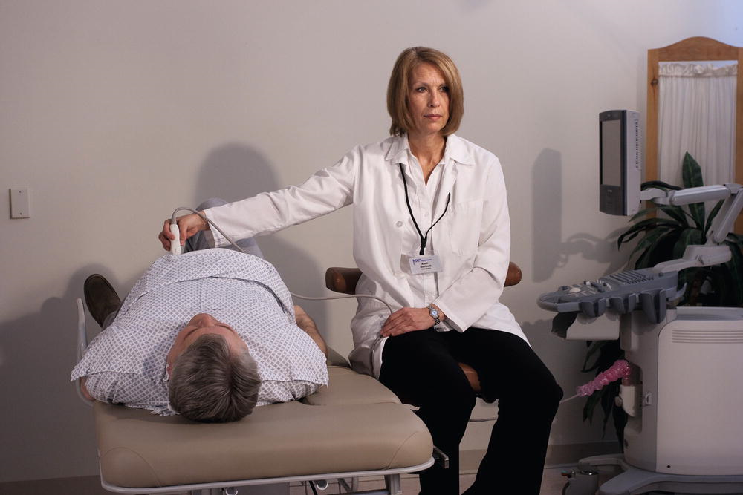
Arm Abduction and Adduction (cont.)
Extreme arm abduction.
Notice the sonographer’s awkward shoulder position.
The repeated use of such awkward positioning of the extremities and torso can result in the development of WRMSDs.

Slide 13
WRMSDs Preventative Pre-Examination Steps
Obtain all necessary equipment for the examination, including gel, towels, and positioning devices.
Choose a comfortable chair that provides good lumbar and foot support and that can swivel.
Position the ultrasound machine where it is directly in front of you, with your eyes even with the top of the monitor. Make sure that the keyboard is in a place that prevents overstretching of your nonscanning arm.
Raise the examination table to prevent excessive leaning, reaching, and bending.

Slide 14
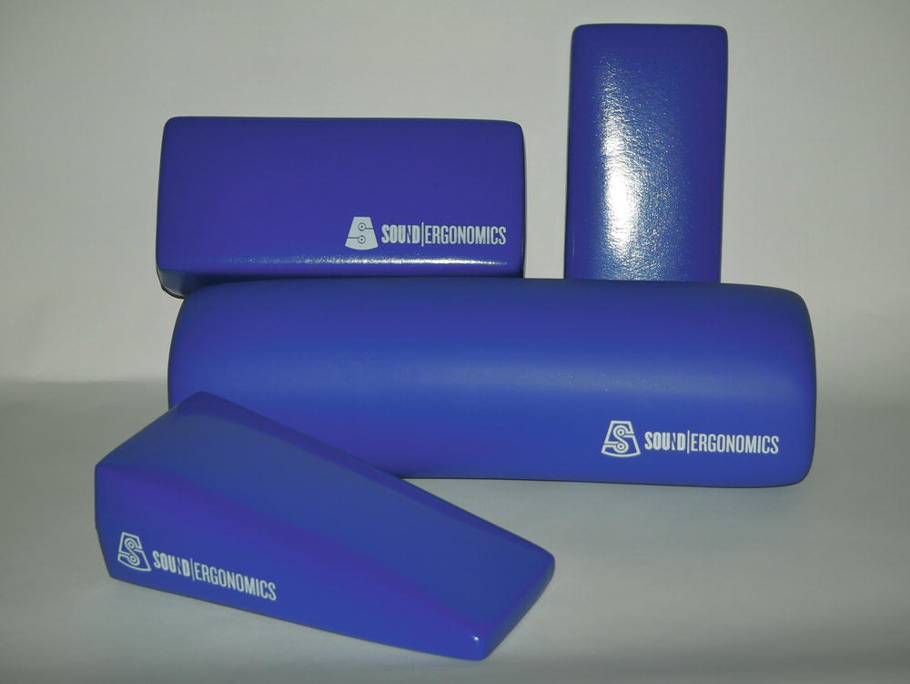
WRMSDs Preventative Pre-Examination Steps (cont.)
Position the patient as close to you as possible to reduce arm abduction and abnormal posturing of the wrist.
Place a support cushion under your scanning arm if needed. Occasionally, you can rest your scanning arm on the patient with permission.
Make appropriate changes to accommodate for good posture throughout the examination when the patient’s position must change. For example, if the patient must roll on his or her right side away from you, then you may need to stand to perform some of the examination.

Slide 15
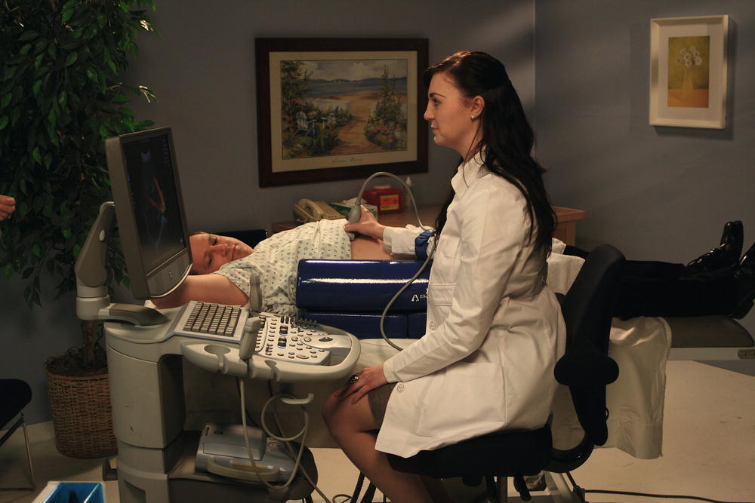
WRMSDs Preventative Pre-Examination Steps (cont.)
Example of how support cushions can be utilized during scanning

Slide 16
Repetitive Motions and Force or Pressure
The small movements required to manipulate the transducer require the use of many coordinated muscles, tendons, and ligaments.
Muscle fatigue results from applying force while carrying out these movements.
The more force required to perform a job, the more muscle effort is necessary, resulting in decreased blood supply.
The pressure applied with the transducer in combination with sustaining a static posture can lead to static muscle loading.
To counteract problems with force and pressure, periods of exertion should be quickly followed by similar-length periods of rest.
Varying tasks throughout the day can also reduce injury.

Slide 17
Room Design
Room design leads to repetitive motion in a couple of ways:
Most sonography rooms are arranged in a similar manner.
The majority of Echo examinations are performed from the right side of the bed with the use of the sonographer’s left arm.
Varying room design to accommodate ambidextrous scanning could prevent some repetitive injuries.
Room design also includes lighting, air quality, and flooring, which can contribute to eye strain and complications.
Poor room design can affect student learning due to the need to stand in one place for an extended period of time.
It may be best to vary observations from sitting to standing.
Taking breaks and short walks can also be helpful.

Slide 18
Equipment Design
An ergonomically state-of-art ultrasound system and equipment can be obtained for a fraction of the cost of failure to address ergonomics in the workplace.
Machines have become lighter and more ergonomically sound.
Transducers have become lighter and easier to manipulate.
Transducer sizes are variable and specific to machines.
Sonographers can choose specific transducers according to comfort, handling, and maneuverability.
Be aware of the transducers that cause you discomfort and make adjustments.
Sonographers play a vital role in equipment selection.
When in a position of helping choose equipment, work with it a few days and reflect upon alterations that can be made to balance capability with ergonomics.

Slide 19
Tips to Help Prevent Aches at Clinical
Make sure you are fully rested before clinical.
Make sure that you wear comfortable clothing and shoes.
Try to vary your observational body positions
Try to maintain good posture in any body position.
Vary the examinations that you observe if you can.
Ask to scan after or before the sonographer, if only for a few minutes, to vary your body positions and practice good posture.
Stretch between observed examinations.
Take a short walk between observed examinations.
Leave the department during your breaks, especially lunch break.
Inform your clinical supervisor and/or sonography program staff if you are experiencing persistent pain in clinical as a result of observations.

Slide 20
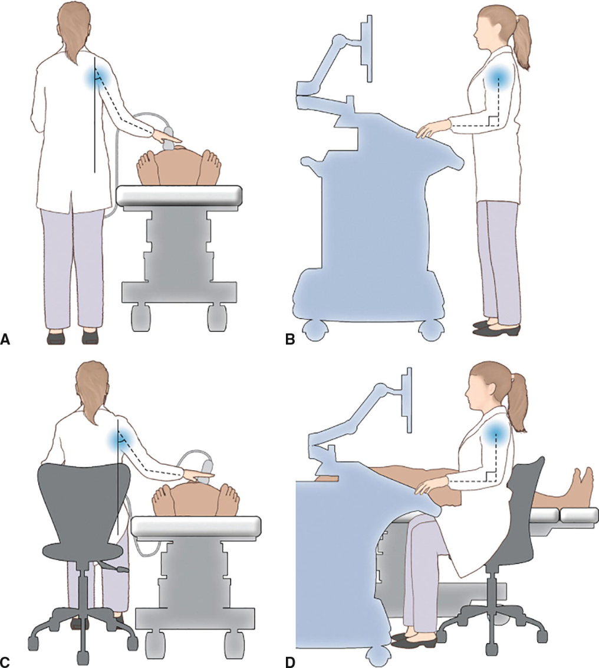
Altering Scanning Positions Can Help!
A. Neutral standing scanning posture with abduction of scanning arm limited to 30 degrees.
B. Neutral standing scanning posture with nonscanning arm close to the body with 90-degree elbow flexion.
C. Neutral seated scanning posture with abduction of scanning arm limited to 30 degrees.
D. Neutral seated scanning posture with nonscanning arm close to the body with 90-degree elbow flexion.

Slide 21
Underlying Predisposing Conditions
Underlying health risks could predispose one to developing a WRMSD. These include:
Previous trauma
Diabetes
Chronic fatigue
Obesity
Smoking
Excessive alcohol consumption
Rheumatoid arthritis
Lyme disease
Conditions associated with excessive flu retention
Having an unhealthy lifestyle

Slide 22
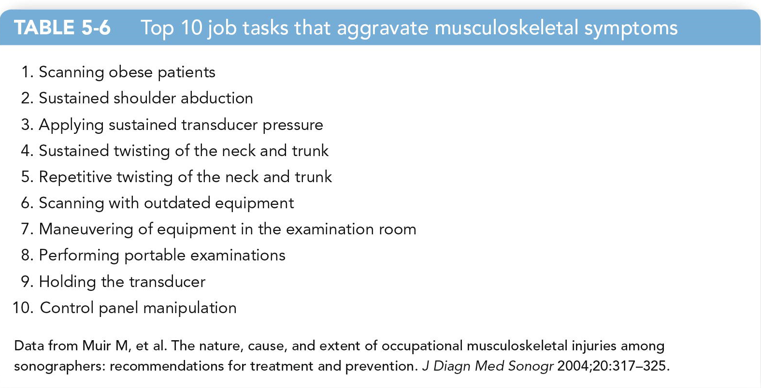
Job Design
A supportive framework can alleviate stressors.
Heavy workloads should include recurrent breaks.
Rotating examination type can impact job design.

Slide 23
Inflammatory Diseases Linked to WRMSDs
Symptoms include inflammation and swelling, numbness, muscle spasms, burning, a “pins-and-needles" feeling, stabbing pain, tingling, or loss of sensation.
Many people do not seek treatment until symptoms are severe.
Early recognition and intervention are vital.
Common universal complications include:
Tendinitis: Inflammation of a tendon
Tenosynovitis: Inflammation of the sheath around a tendon
Epicondylitis: Inflammation of the periosteum in the area of insertion of the biceps tendon on the distal humerus
Bursitis: Inflammation of the bursa within a joint
Pinched nerves: Disorder that results from compression, abnormal stretching, or constriction of a nerve or group of nerves

Slide 24
Locations for Pinched Nerves for Sonographers
Common locations for pinched nerves for the sonographer are the elbow, wrist, and neck.
Some examples of nerve entrapment syndrome that affect the sonographer are carpal tunnel syndrome, cubital tunnel syndrome, and thoracic outlet syndrome

Slide 25
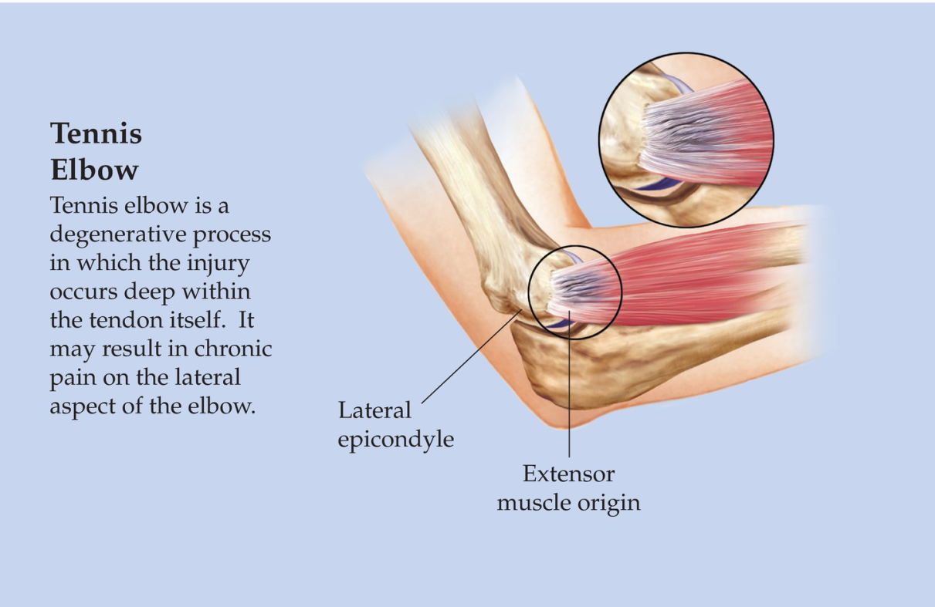
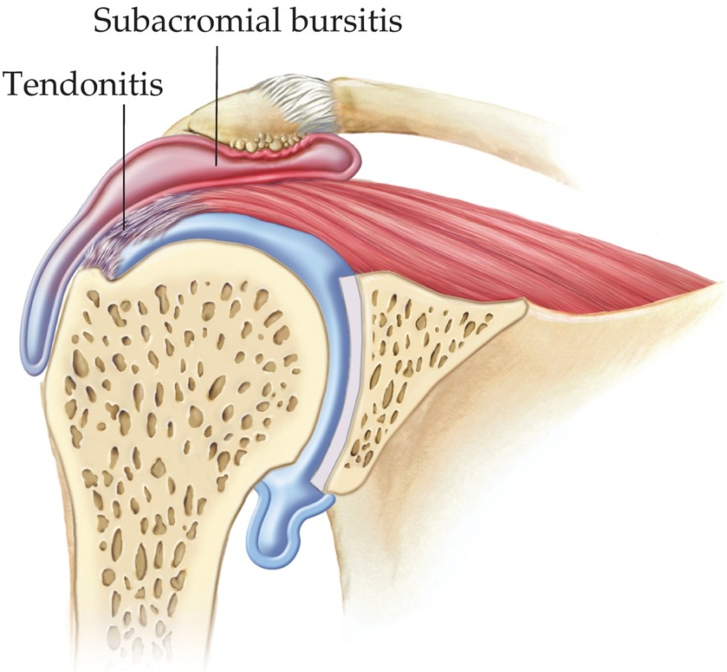
Inflammatory Diseases Linked to WRMSDs
Tennis elbow and shoulder bursitis and tendinitis

Slide 26
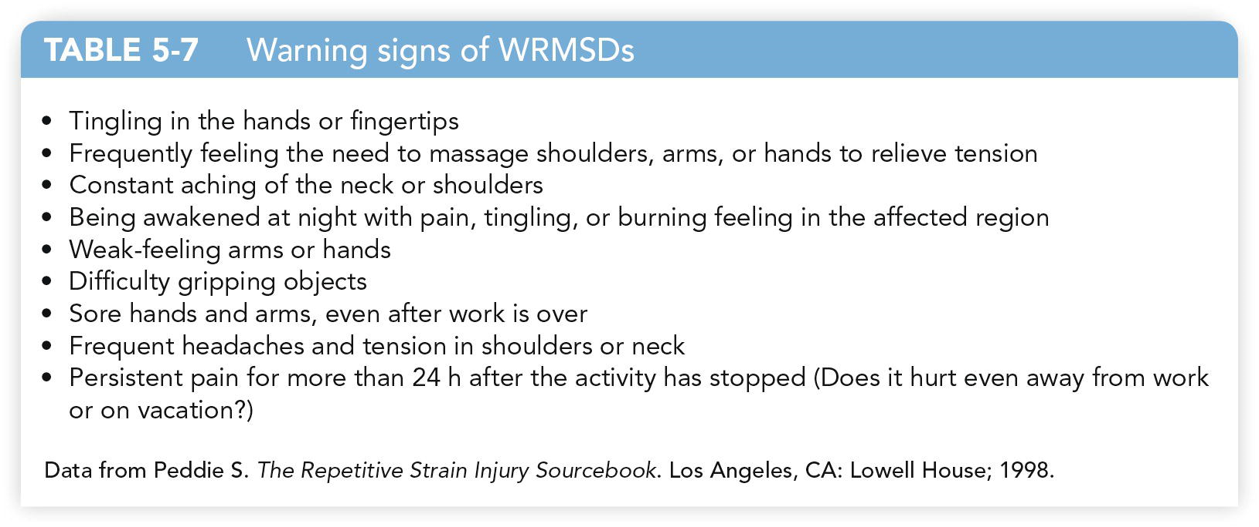
Inflammatory Diseases Linked to WRMSDs (cont.)
Warning signs of WRMSDs!!

Slide 27
Best Practice and Ergonomic Interventions for the Sonography Student
Prevention is the best treatment for WRMSDs:
Ergonomic interventions
Conditioning and stretching exercises
Shoulder and elbow:
Use no more than a 30-degree angle of abduction.
Position the patient as near to you as possible.
Use a cable support brace or shoulder assist.
Be mindful of static forceful scanning, which can injure the elbow.
Position the nonscanning arm so the elbow is at a 90-degree angle and the upper arm hangs freely at the side.

Slide 28
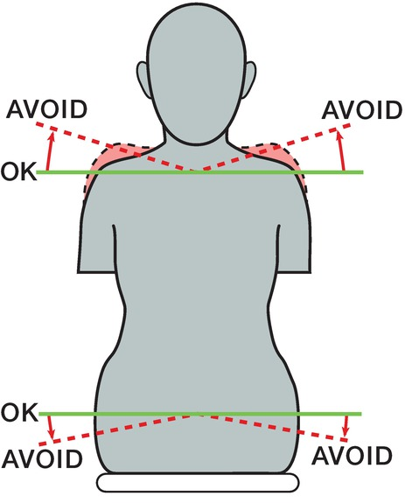
Best Practice and Ergonomic Interventions for the Sonography Student (cont.)
The goal is to have the shoulder in a horizontal line, with the weight evenly balanced when seated.
Try to avoid lifting the shoulders toward the ears, hunching your shoulders forward, and sitting with most of your weight on one hip.

Slide 29
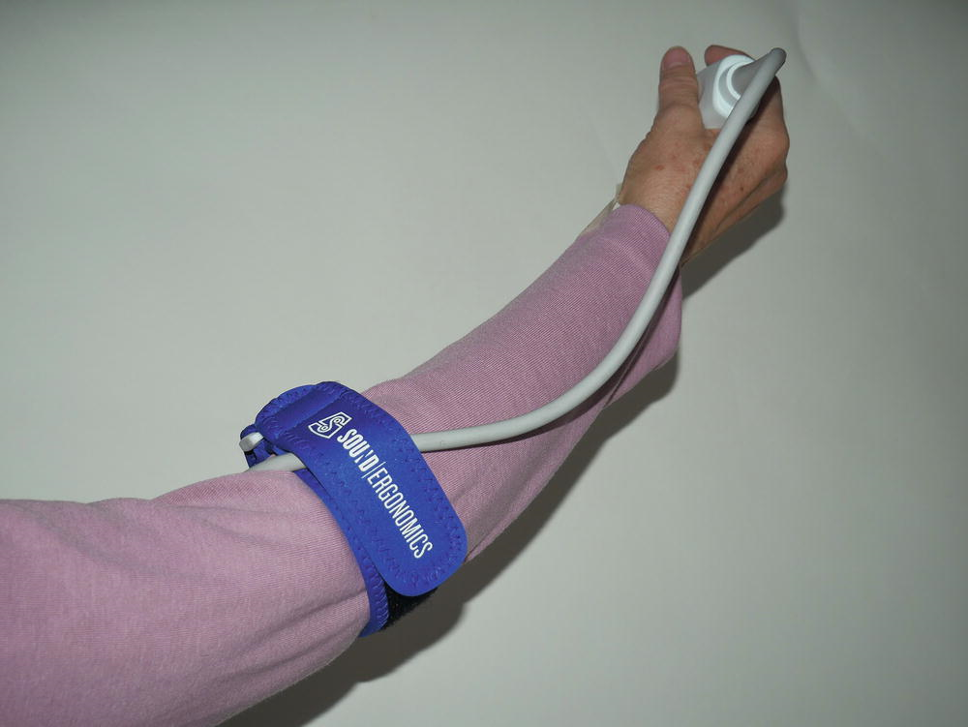
Best Practice and Ergonomic Interventions for the Sonography Student (cont.)
Cable support brace sold by Sound Ergonomics.

Slide 30
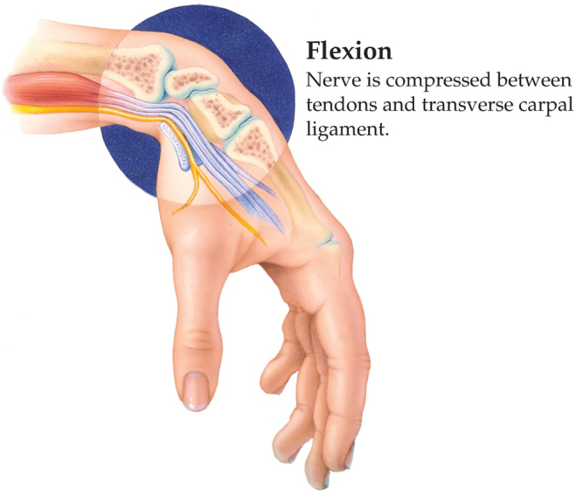
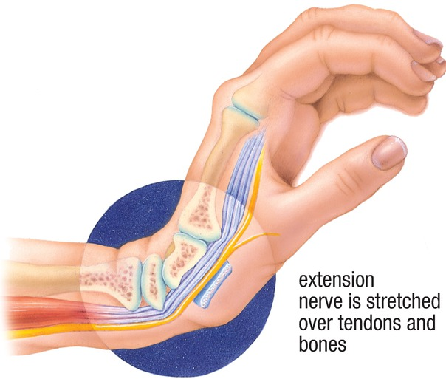
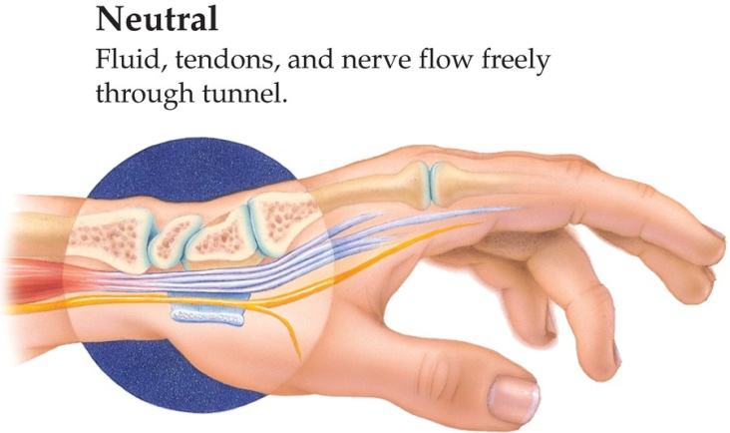
Best Practice and Ergonomic Interventions for the Sonography Student (cont.)
Wrist and hand:
Any movement that requires the wrist to be taken out of neutral position reduces its strength.
Be mindful of repetitive gripping action.
If ganglion cysts occur, they should be drained or surgically removed.
Make use of cable support braces and wrist braces.

Slide 31
Best Practice and Ergonomic Interventions for the Sonography Student (cont.)
Neck and back:
Pain can manifest because of repetitive twisting in the neck and trunk and can led to spinal dysfunction.
Alter your position and take occasional short breaks.
Prevent twisting by placing the ultrasound machine as close as possible to the examination table; manipulate the monitor to reduce neck twisting.
When standing, keep your spine straight with your weight evenly distributed between both legs.
Postural support devices can reduce neck and back strain.

Slide 32
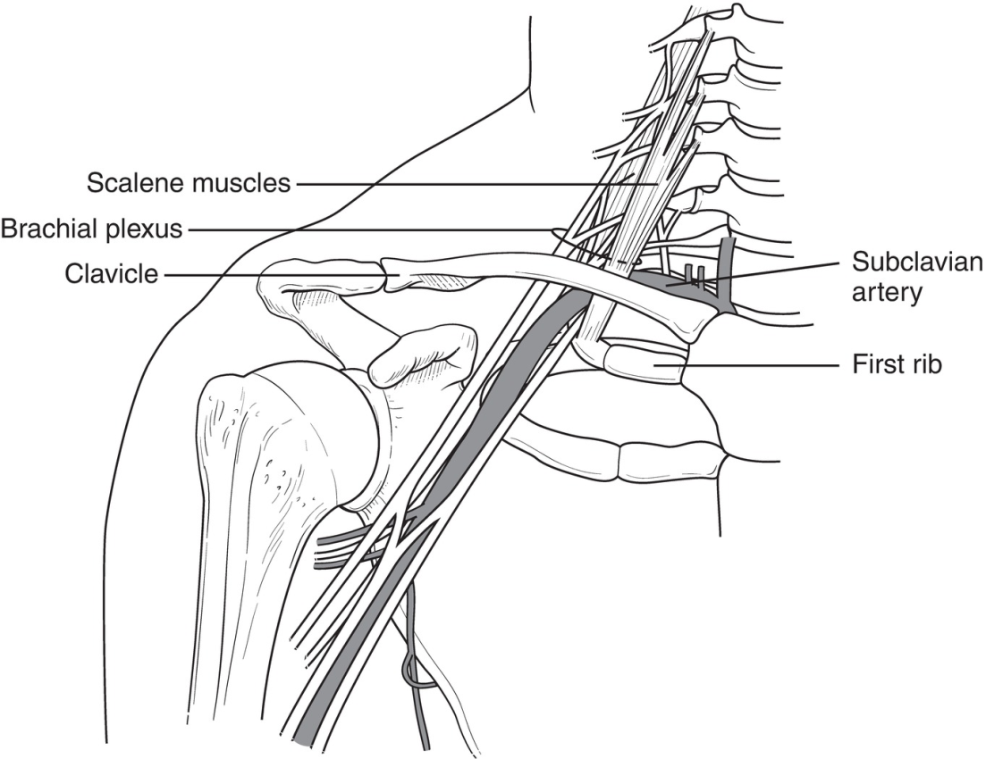
Best Practice and Ergonomic Interventions for the Sonography Student (cont.)
Thoracic outlet syndrome is a painful disorder of the fingers, hand, and possibly the wrist due to the compression of the brachial nerve plexus and vessels between the neck and shoulder.
It can cause by tilting the head forward, hunching the shoulders forward, or continuously reaching overhead.

Slide 33
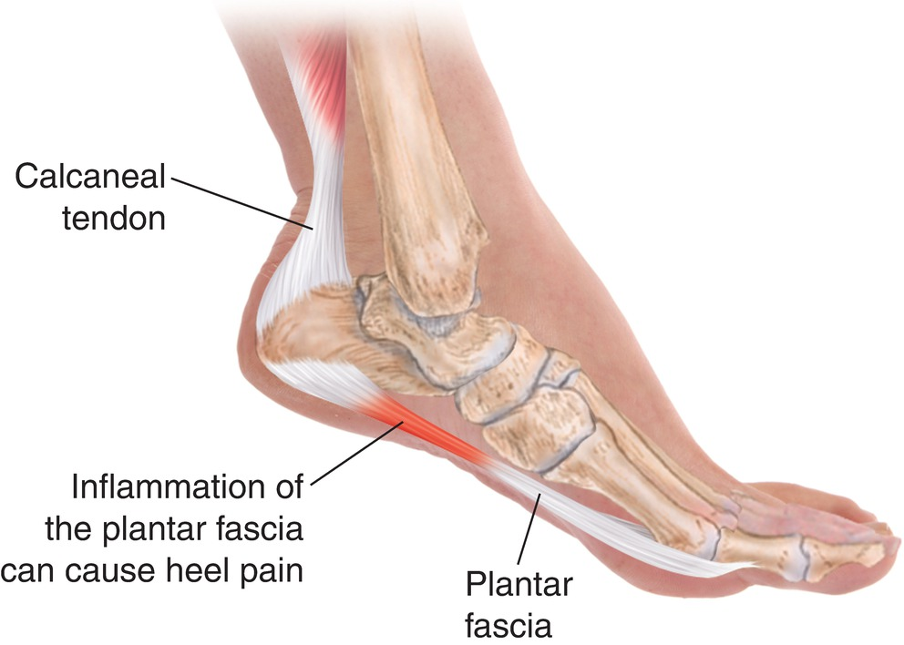
Best Practice and Ergonomic Interventions for the Sonography Student (cont.)
Lower extremities:
Personal orthotic devices can be worn on the foot and ankle to prevent pain associated with plantar fasciitis.
These can also treat tarsal tunnel syndrome.
Orthotic shoes may remedy foot pain.

Slide 34
General Treatment of WRMSDs and Lifestyle Impact
The most common treatment is rest and anti-inflammatory medications.
Other options include:
Chiropractics
Massage therapy
Acupuncture
Fitness programs
Athletic programs
Trigger point injections
Herbal treatments
Physiotherapy
Work closely with a qualified physician.
WRMSDs can drastically affect your job, lifestyle, and emotional well-being.
Take immediate action if you feel you may be developing a WRMSD.

Slide 35
Summary
WRMSDs are either occupationally acquired or occupationally aggravated injuries to an individual’s muscles, tendons, ligaments, and cartilage that result from repetitive use.
The most common locations of WRMSDs for sonographers are the shoulder, neck, wrist, back, and hands.
By being aware that your new chosen profession could offer some physical challenges for you in the future, you can mediate and try to prevent these challenges early in your career.
Be cognizant of pain that you experience in the initial days of your training and make alterations immediately in order to enjoy the profession that you have chosen for many years.

